Slide 1
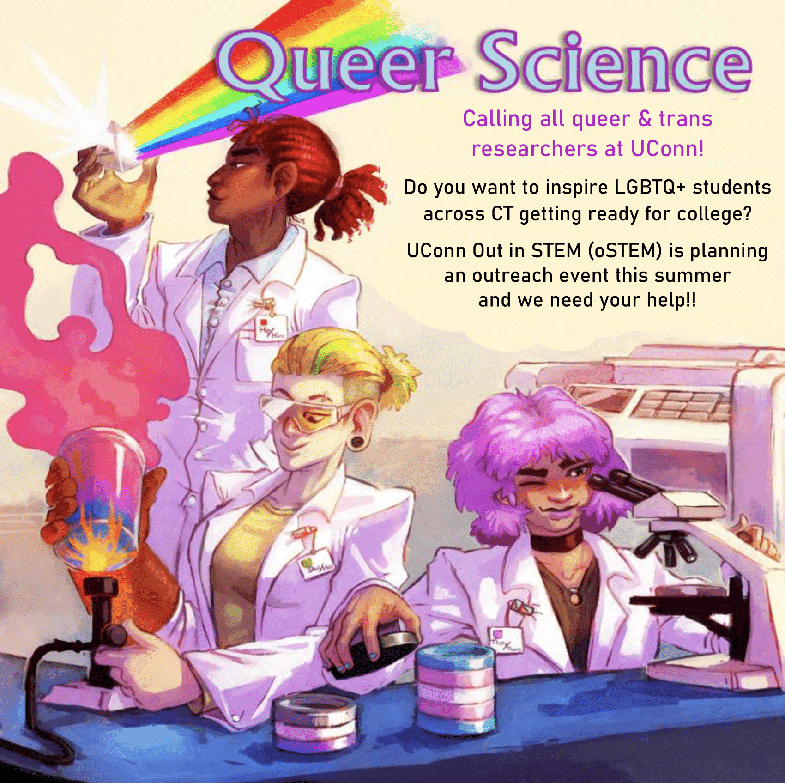
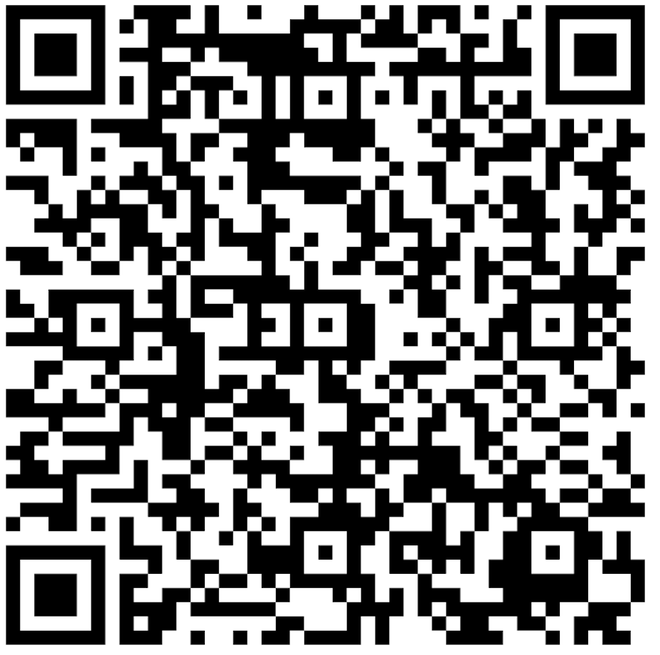
Calling all queer & trans graduate and undergraduate students at UConn!
Do you want to inspire LGBTQ+ students across CT who are getting ready for college?
The Vergnano Institute for Inclusion (VII) is planning an outreach event at UConn this summer and we need your help!
Artwork by @Kylogram
Interested in joining our team? Register by scanning the QR code or navigating to the link below!
http://tinyurl.com/QSVolunteer

