Slide 1
Strawberry DNA Extractions

Slide 2
Introductions
Pronouns:
Major
Fun Fact:
Insert image here
Name

Slide 3
Introductions
Pronouns:
Major
Fun Fact:
Insert image here
Name

Slide 4
What is DNA?
DNA stands for Deoxyribonucleic Acid
group of molecules that is responsible for carrying and transmitting hereditary information from parent to offspring
Human DNA consists of about 3 billion bases, and more than 99 percent of those bases are the same in all people.
The order, or sequence, of these bases determines the information available for building and maintaining an organism.

Slide 5
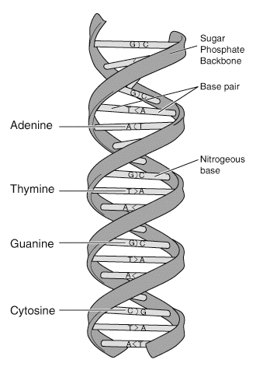
What is DNA?
The information in DNA is stored as a code made up of four chemical bases:
adenine (A)
guanine (G)
cytosine (C)
thymine (T)

Slide 6
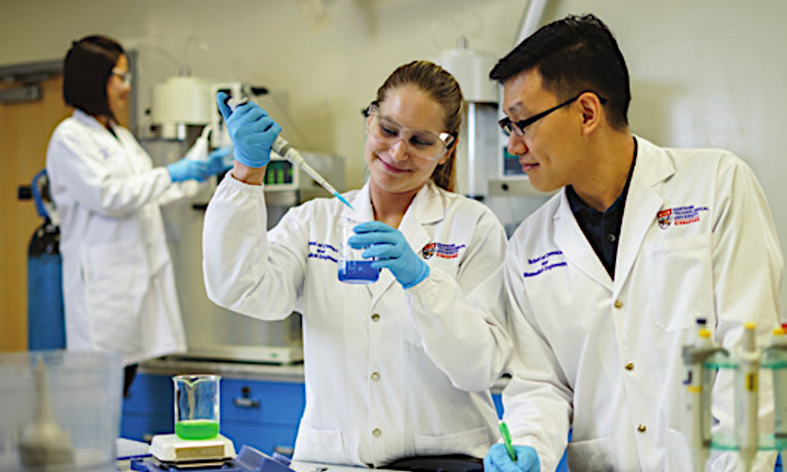
Related Majors: Chemical Engineering
Work in laboratories or industrial settings to oversee production
produce a variety of chemicals and products, such as electronics, food, clothing, and paper
Involves math and science (particularly chemistry) to overcome technical challenges safely and economically

Slide 7
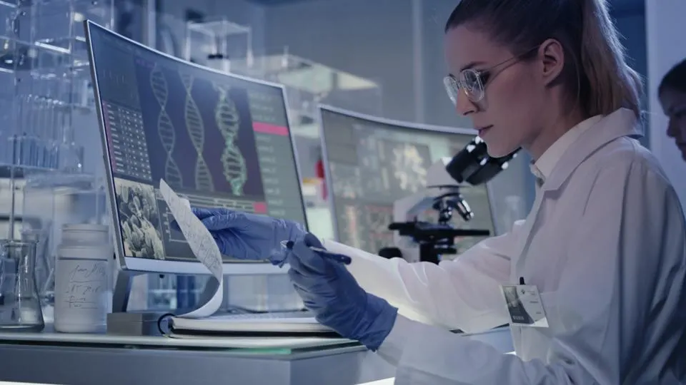
Related Majors: Biomedical Engineering
Work in universities, hospitals, and research facilities of educational and medical institutions
Their responsibilities include designing equipment and devices, such as artificial internal organs, replacements for body parts, and machines for diagnosing medical problems
Involved math, biology, science,

Slide 8
Majors Offered at UCONN
Chemical & Biomolecular Engineering: study and design chemical manufacturing processes and solve problems that involves chemicals, fuel, food, and more
Biomedical Engineering: focuses on advances in technology and medicine to design new devices/equipment to improve human health
Notes:
Volunteer talk about these experience in this major

Slide 9
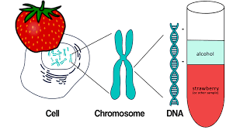
Activity
Have you ever wondered what DNA looks like is real life?
In this activity you will be extracting the DNA of a strawberry! Once you extract the DNA you can put it in a necklace to show others.
Notes:
Need to format better

Slide 10
In Your Kit
1 strawberry
Ziploc bag
Test tube
Cheesecloth
Rubber bands
Pipette
Glass rod
Extraction buffer
1 wooden stirrer
1 necklace string

Slide 11
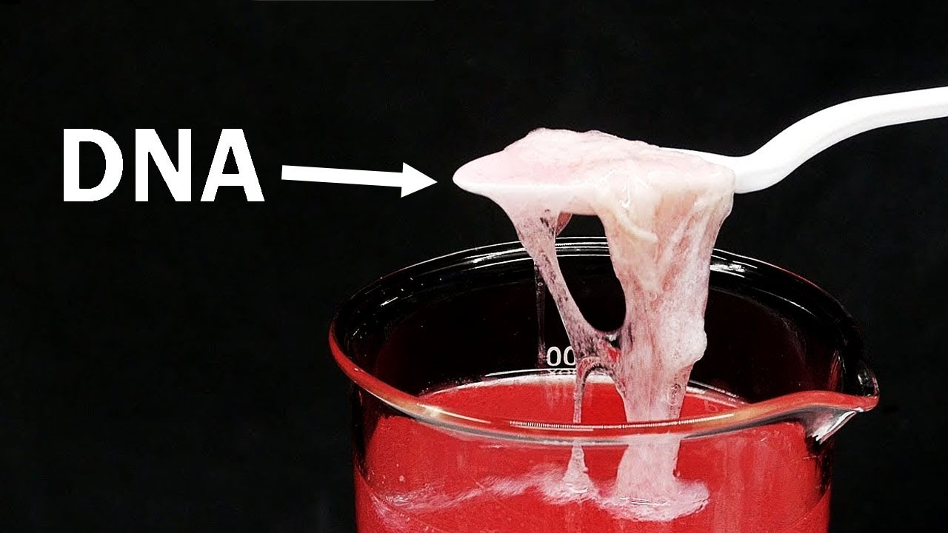
Get Started!
Ask questions, work together, and problem solve!

Slide 12
Discussion Questions
Why did you need to mash the strawberries?
What is in the extraction buffer? Why is that significant?
Remember, it’s made from salt and dishwashing detergent
What is the alcohol’s role in this experiment? Why does it need to be cold?
What makes the DNA clump together in the test tube?
Notes:
Should i include answer key to these questions?

Slide 13
Reflection
What did you guys enjoy?
What did you find difficult?
What would you change?
What are some other fruits you think we could use instead?

