Slide 1
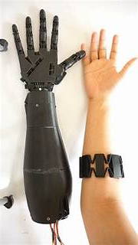
Robotic
Hand
MYO Workshops 2023

Slide 2
Meet our Team:
Name:
Name Text Box
Major:
Major Text Box
Photo Here
Pronouns:
Pronouns Text Box

Slide 3
Meet our Team:
Name:
Name Text Box
Major:
Major Text Box
Photo Here
Pronouns:
Pronouns Text Box

Slide 4
What is Biomedical Engineering?
.

Slide 6
All Engineering at UCONN:
Majors Offered:
Biomedical Engineering
Chemical and Biomolecular
Civil Engineering
Computer Engineering
Computer Science
Computer Science and Engineering
Electrical Engineering
Multidisciplinary Engineering
Environmental Engineering
Management and Engineering for Manufacturing
Material Science Engineering
Mechanical Engineering
Questions?
Notes:
Each of the volunteers can talk about their experiences at UCONN and with the school of engineering and then take questions about it.

Slide 7
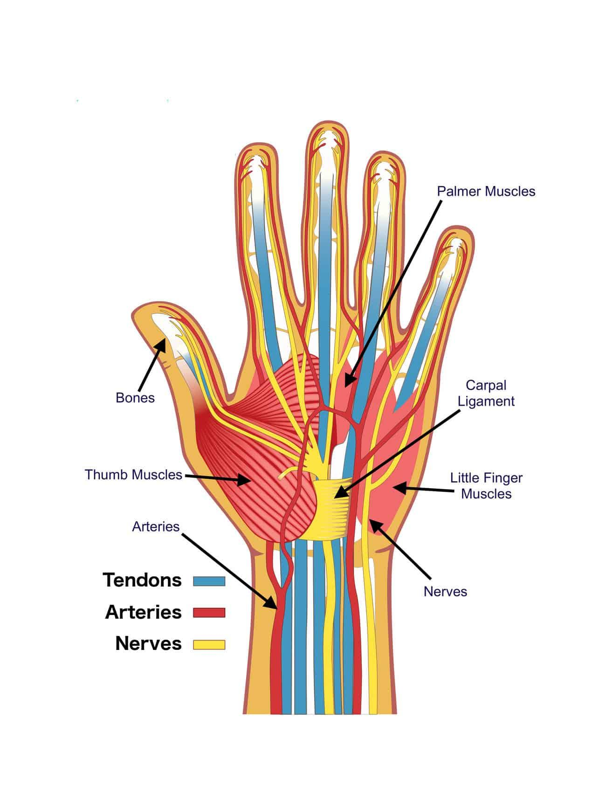
How our Hands Work and Thumb Experiment
.
Notes:
I recommend that the volunteers familiarize themselves with just basic stuff on how the hand works before we start the workshop. There is also a worksheet that will go along with this part along with a mini experiment.
In the experiment everyone will get to test out what it would be like to not have thumbs and try picking up various objects after taping their thumb down.
This video is very helpful in the first 7 minutes https://www.youtube.com/watch?v=hB6xXXxcPKg
Some basic facts to know:
There is no muscles in our fingers, however we have ligaments, tendons and bones
The tendons are responsible for contracting our fingers and our muscles in our forearms and hands help move the tendons
Our thumbs are special due to the fact that they are opposable and their strength
After just talking about hands you can talk about how we need to combine this information with our mechanical engineering skills when creating prosthetics.

Slide 8
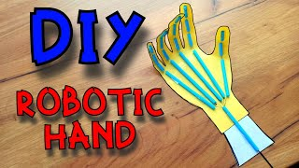
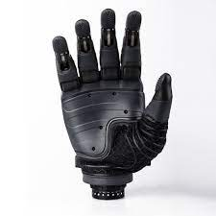
The Robotic Hand
.
Notes:
It may be easier to play this video on a faster speed just to show everyone quick what they are doing and then I recommend that you demo building the hand alongside as everyone makes theirs.

Slide 9
Building our Robotic Hands
Step 1: Trace out our hands on the paper provided
Step 2: Draw lines to simulate the different parts of our fingers
Step 3: Use the straws and tape them to the lines on our traced out hand
Step 4: Draw and cut out our wrists, then tape the wrist to our hand
Step 5: Feed the strings through the straws and test out our new robotic hands
Notes:
I would leave this on the screen as the girls are creating their robotic hands, just so that they can look back up at it if they are unsure. The video can also be played again if needed as well.

Slide 10
Discussion/Reflection
After this activity why do you think it is important for biomedical engineers to be familiar with so many other types of engineering?
What was the hardest part of building your robotic hand and if this were to be done differently what would you change to improve your hand?
Why are our thumbs so important and how was it to try and use your hands without thumbs?
What was your favorite part of this workshop and what would you change about it?

