Slide 1
Marble Roller Coaster Challenge

Slide 2
Introductions
Insert picture of yourself here!
Insert picture of yourself here!
Name
Name
Pronouns:
Major:
Fun Fact:
Pronouns:
Major:
Fun Fact:

Slide 3
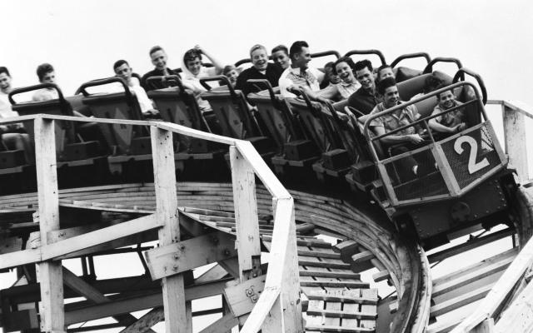
History of Roller Coasters
First patented by LaMarcus Adna Thompson, the “father of gravity”
Popularized roller coasters in the 1880s for tourists
Typically made out of steel or wood
Tallest roller coaster is 456ft and the fastest roller coaster goes up to 149mph!
Engineering of roller coasters involves
Transfer of energy
Design skills
Safety considerations

Slide 4
Energy
Type
Definition
Application
Roller coaster drop
Car in motion
Kinetic Energy
Energy of an object in motion
Roller coaster at the top of a hill
Ball about to dropped
Potential Energy
Energy of an object due to its relative position

Slide 5
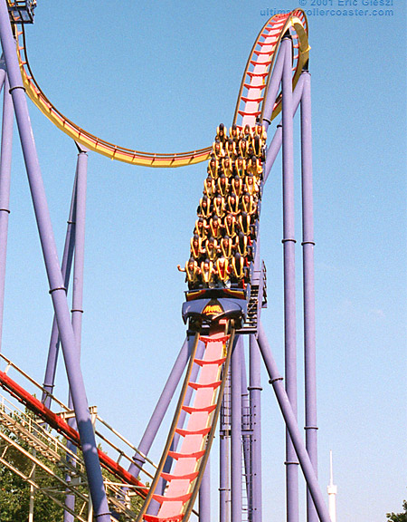
Velocity, Acceleration & Momentum
Velocity – speed of an object in motion
Acceleration – rate of change of velocity; increase in velocity
Ex: a car accelerates down a hill
Momentum – the quantity of motion of a moving body
Quantified by multiplying mass and velocity of an object in motion
Both acceleration and momentum are relative to the velocity of the object
Factors that can impact these concepts:
Mass
Air resistance (drag force)
Other forces acting on the object in motion

Slide 6
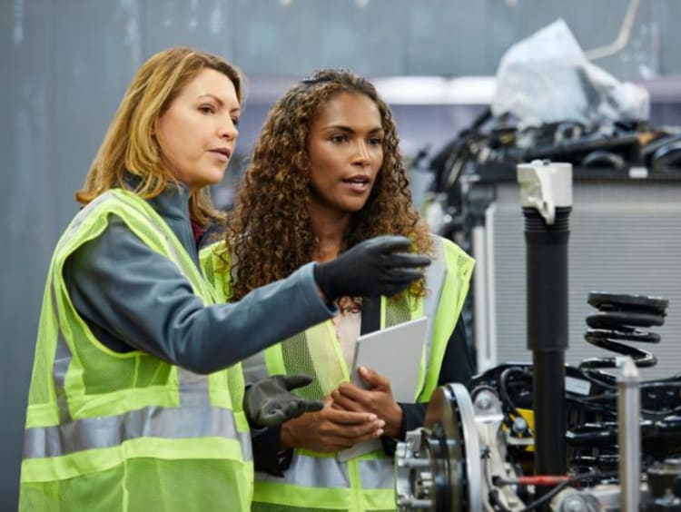
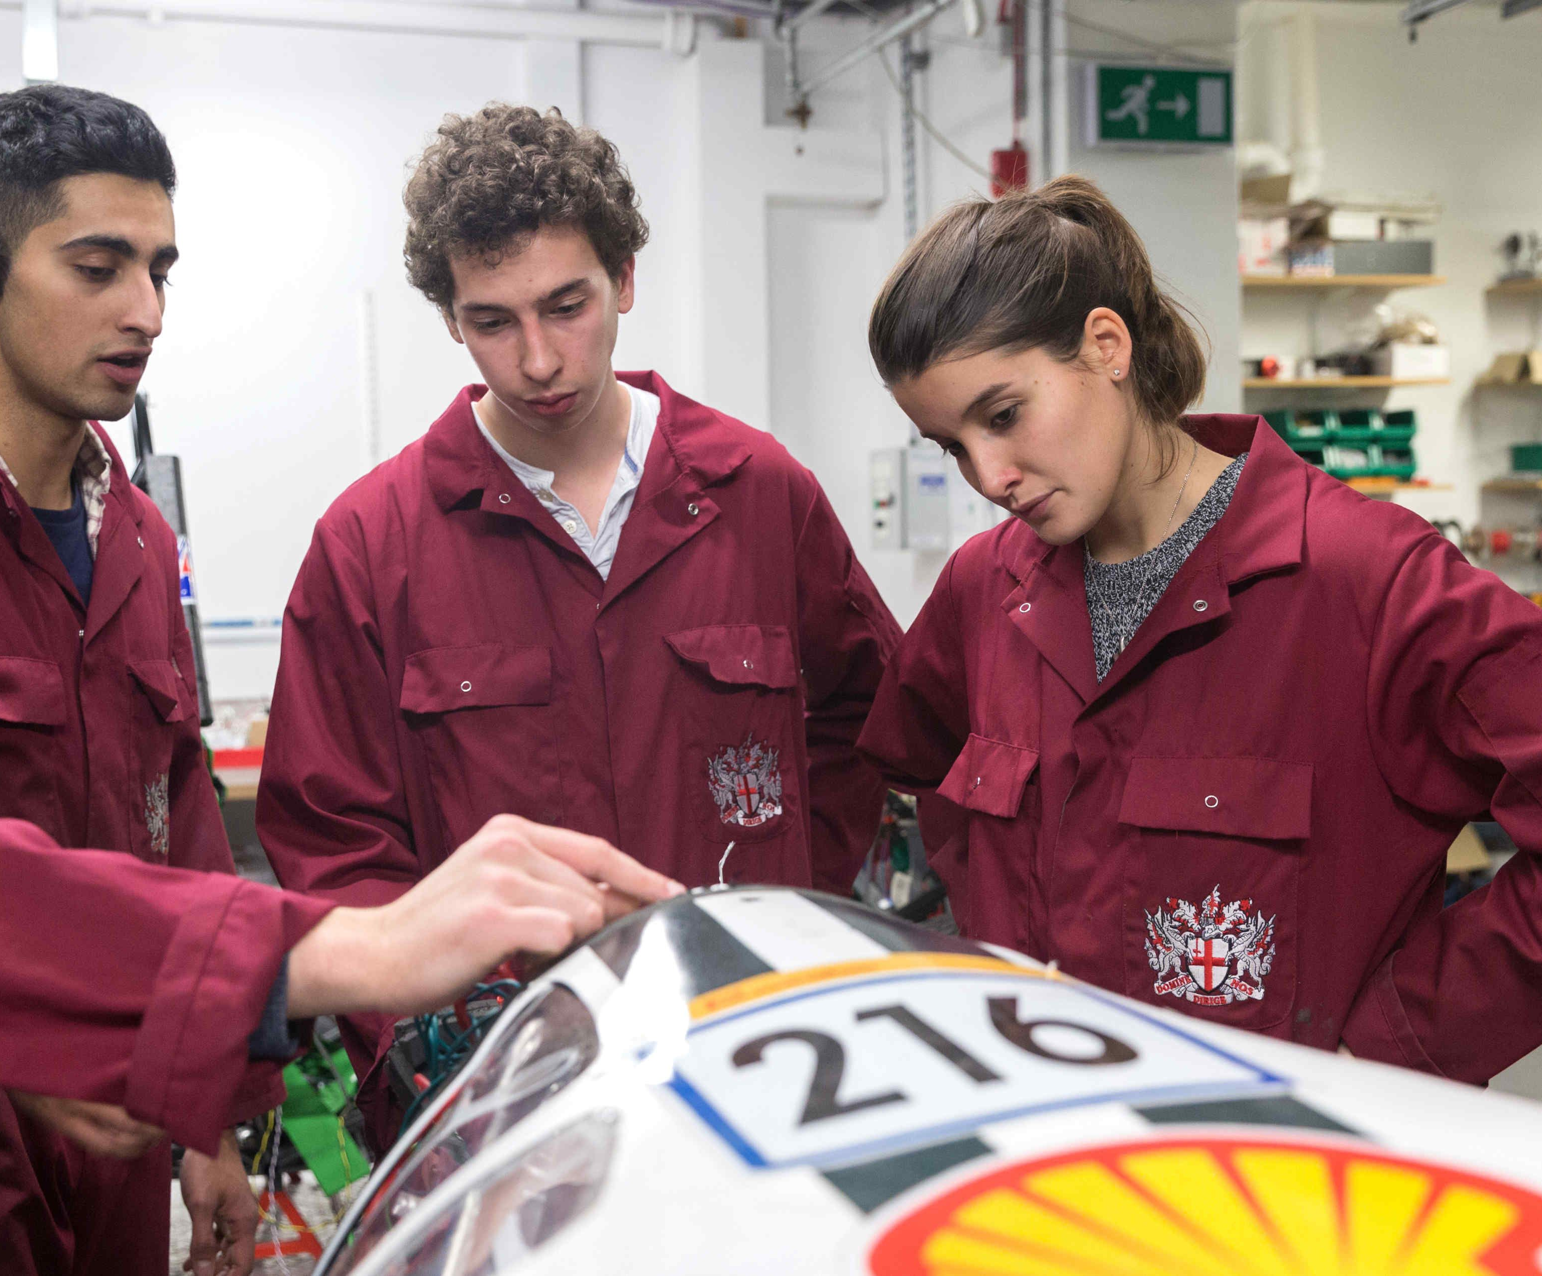
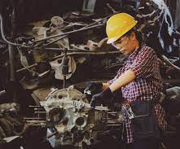
Mechanical Engineering
What do they do?
Study objects in motion
Develop new materials, devices, and processes
Improve upon designs through testing, experimentation, etc.
Common careers: Aerospace, automotive, biotechnology, construction

Slide 7
Your Challenge:
In GROUPS of 3-4, construct a marble roller coaster out of given materials that is stable, safe, and earns the most points.

Slide 8
Materials
5 rubber bands
Tape
Plastic cup
5 popsicle sticks
2 pieces of paper
6ft insulation tubing

Slide 9
Get Started!
Point System:
Flat: 1 point
Hill: 2 points
Loop: 5 points
Gap jump/Drop: 7 points
Ask questions, work together, and experiment!

Slide 10
Our Design
Insert pictures of your design here!
(Or you can present it in person if you bring your model)
Slide can be removed if volunteers do not have an example, go around and have students present theirs instead

Slide 11
Discussion Questions
How does transfer of energy help move the marble through your roller coaster?
How would a larger/smaller marble affect your design?
What went well with your design and why?
What could have improved and how?

Slide 12
Thank you!
Have a great time at the rest of Multiply Your Options ☺
If you have any questions for us, don’t hesitate to ask!

