Slide 1
Marble Roller Coaster Challenge

Slide 2
Introductions
Insert Picture
Insert Picture
Name #1
NAME #2
Pronouns:
Major:
Fun Fact:
Pronouns:
Major:
Fun Fact:

Slide 3
Roller Coasters
First patented by LaMarcus Adna Thompson, the “father of gravity”
Popularized roller coasters in the 1880s for tourists
Typically made out of steel or wood
Tallest roaster is 456 ft and the fastest roller coaster goes up to 149 mph!
Engineering of roller coasters involves
Transfer of energy
Design Skills
Safety Considerations

Slide 4
Energy
Type
Definition
Applications
Kinetic Energy
Energy of an object in motion
Roller Coaster
Car In Motion
Energy of an object due to its relative position
Roller coaster at the top of a hill
Ball about to drop
Potential Energy

Slide 5
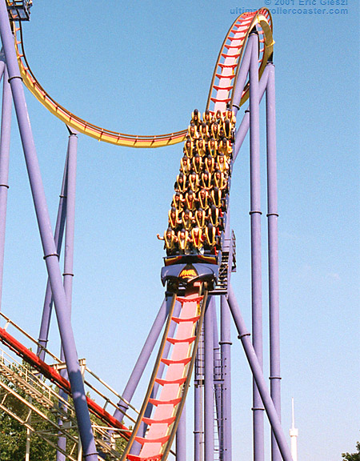
Velocity, Acceleration & Momentum
Velocity – Speed of an object in motion
Acceleration. - rate of change of velocity; increase in velocity
Ex: A car accelerates down a hill
Momentum – the quantity of motion of a moving body
Calculated by multiplying the mass and velocity of an object in motion
Both acceleration and momentum are relative to the velocity of the object
Factors that can impact these concepts:
Mass
Air Or Friction Resistance (Drag Force)
Other forces acting on the object in motion

Slide 6
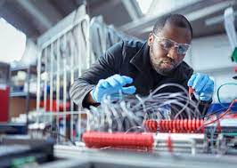
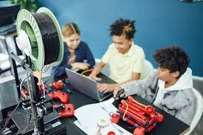
Mechanical Engineering
What Do they Do?
Study objects in motion
Develop new materials, devices, and processes
Improve upon designs through testing, experimentation, etc.
Common careers: Aerospace, automotive, biotechnology, construction

Slide 7
Your Challenge
Construct A Marble Roller Coaster out of the given materials that is stable, safe, and could complete all of the challenges

Slide 8
Materials
6 Rubber Bands
Tape
4 Paper Cups
Insulation Tubing (Foam)
2 Marbles

Slide 9
Get Started!!
Directions:
Split off into Teams of 3
Work Together To Build Your Roller Coaster
Follow The Sample Roller Coaster Design As A Template, but use your IMGINATION, CREATIVITY, AND SKILLS!
Ask Questions, Work Together, And Experiment

Slide 10
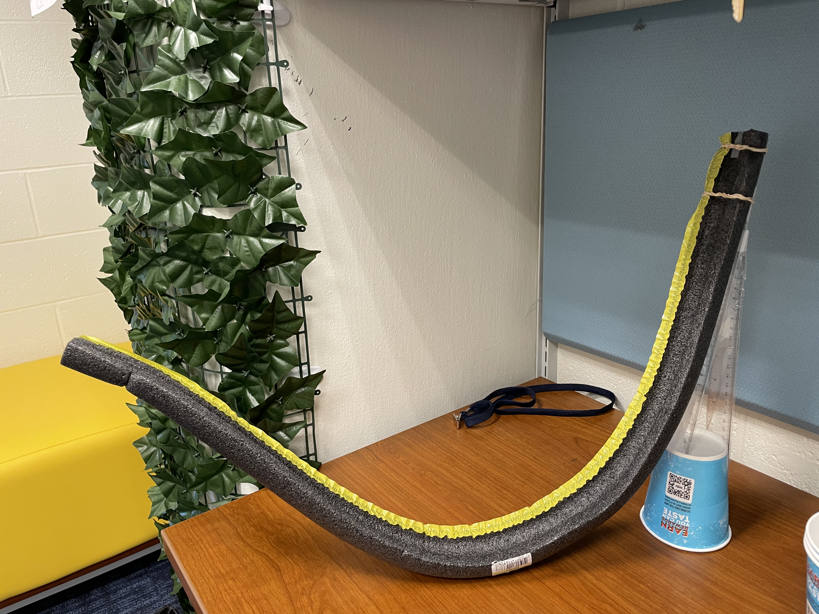
OUR DESIGN

Slide 11
DISCUSSION QUESTIONS
How does transfer of energy help move the marble through your roller coaster?
How would a larger/small marble affect your design?
What went well with your design and why?
What could have improved and how?

Slide 12
Thank You !
Have a great time at the rest of Engineering Your Future ☺
If you have any questions for us, don’t hesitate to ask !

