Slide 1
Code a Rocket Launch
Engineering Your Future Fall 2023

Slide 2
OUR TEAM
VOLUNTEER 1
VOLUNTEER 2
MAJOR
MAJOR

Slide 3
Margaret Hamilton NASA's First Software Engineer

Slide 4
Majors Offered at UConn
Computer Science (CS)
Covers fundamental topics in the theory, principles, and practices of computing
Computer Science and Engineering (CSE)
Broad perspective in both software and hardware topics relevant to computing systems.

Slide 5
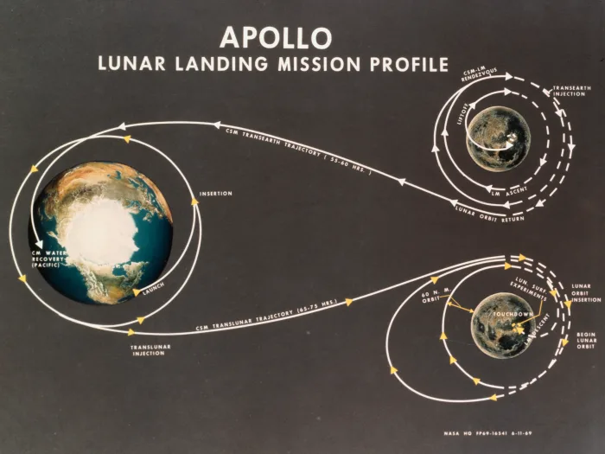
Problem Statement
Margaret Hamilton needs help checking if the NASA Apollo team will make it to the moon!

Slide 6
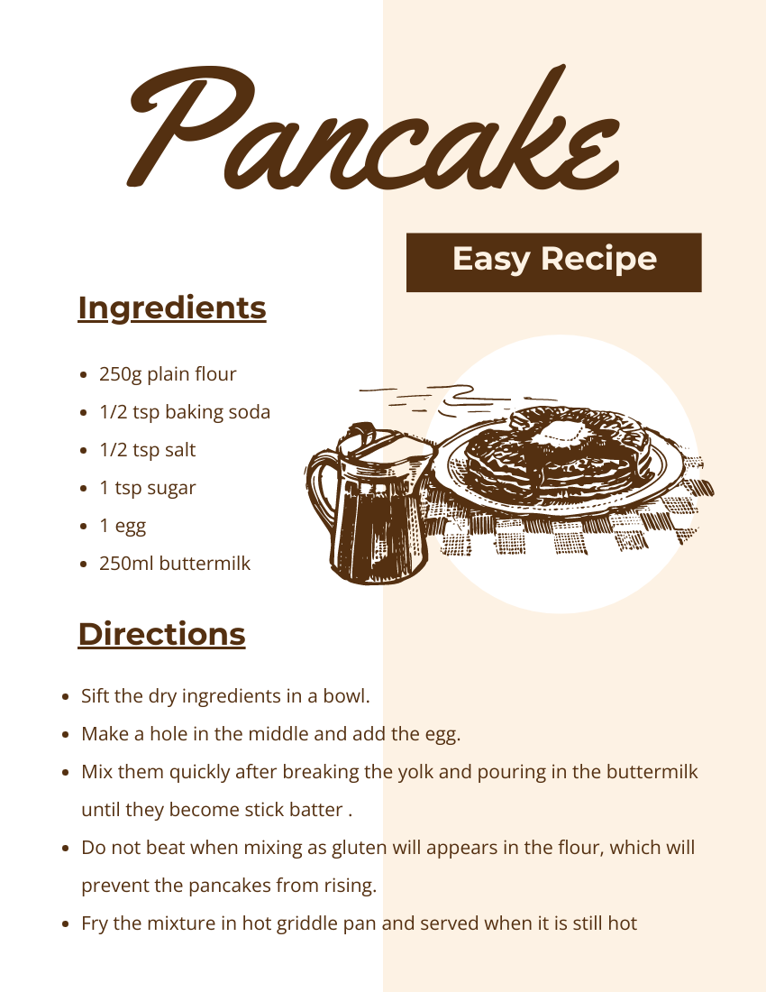
Algorithms
To direct the actions of a computer, programmers rely on algorithms
An algorithm is a set of steps that can be followed from start to finish to complete a task
What are some algorithms you
use in your everyday life?

Slide 7
Programming Languages
Programming languages are the tools we use to write instructions for computers to follow.
Computers “think” in binary — strings of 1s and 0s. Programming languages allow us to translate the 1s and 0s into something that humans can understand and write.
Today we will be writing our code in the Python language!

Slide 8
Variables
Variables are how computers store data (words, letters, equations, numbers, etc...)
Variables storing words must be in quotes
Creating Variables:
Code Format:
[variable name] = [value]
Examples:
X = 10
Name = "Joe"

Slide 9
Output
print() is a command given to a computer for outputting
The Computer will display anything within the print commands parenthesis
Example:
Code:
Output:

Slide 10
User Input
input() is a command given to a computer for receiving and storing input into variables
If asking user for a number value, use int() function
Getting User input:
Code Format:
[variable name] = input()
Examples:
name = input()
age = int(input())

Slide 11
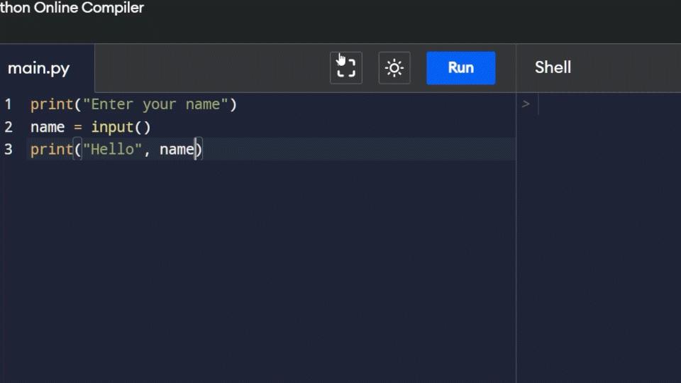

Slide 12
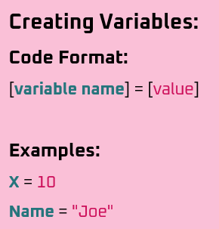
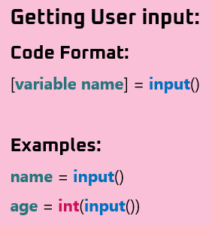
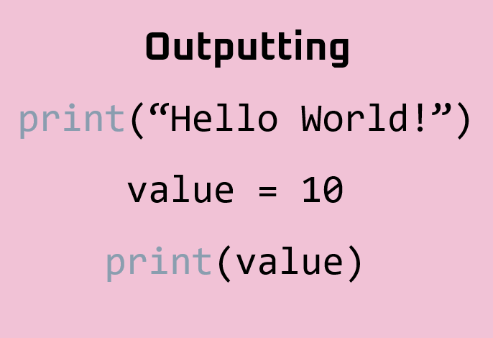
Problem - Almost there? Objective: Find how far the rocket is from the moon
Make variable for moon_height, rocket_height, distance a. Moon is 238,900 miles from Earth b. Get input for current rocket height // *use int() for number inputs c. Compute the distance between the moon and rocket
Output distance
Tools For Solving The Problem

Slide 13
The Rocket Made it to the Moon!
https://www.codecademy.com/resources/blog/programming-languages/

