Slide 1
Bath Bomb Creations!
MYO SPRING 2022

Slide 2
Hey!
I’m (Volunteer 1)
Pronouns
Year
Major
Why you joined STEM
Insert Image

Slide 3
Hi!
I’m (Volunteer 2)
Pronouns
Year
Major
Why you joined STEM
Insert Image

Slide 4
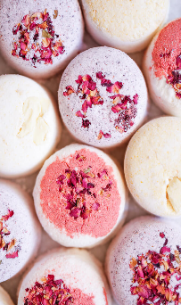
What are Bath Bombs?
Have you ever used a bath bomb before? What was your experience like?
What do you think are some of the ingredients that go into a bath bomb?
How do you think a bath bomb works?
Notes:
*Read Questions one at a time and wait for interaction from audience in the chat. If no response is given, answer your own suggestions and share your experiences!*
*For the last question (hyrdophobic or hydrophilic), do not provide the definition. Instead, ask them to think about what the words might mean, emphasizing hydro, phobic, and philic and providing real words with those roots, and then ask them to place their guesses*
Bath Bombs are fun, single-use fragrances that dissolve in contact with water. They come in all shapes, colors, sizes, and can add a pleasant aroma to any bath! You will get to decide what color and decorations you want to add. We will go through it step by step together, as it involves using lots of ingredients. If you have any questions, please don’t hesitate to ask!

Slide 5
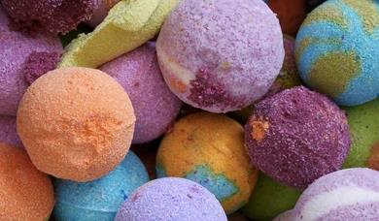
A Bath to Remember!
Bath Bombs are fizzy soap-molds that dissolve in water, releasing beautiful colors and smells in the bath!
Notes:
Bath Bombs are fun, single-use fragrances that dissolve in contact with water. Producing that famous fizz. They come in all shapes, colors, sizes, and can add a pleasant aroma to any bath! You will get to decide what color and decorations you want to add. We will go through it step by step together, as it involves using lots of ingredients. If you have any questions, please don’t hesitate to ask!

Slide 6
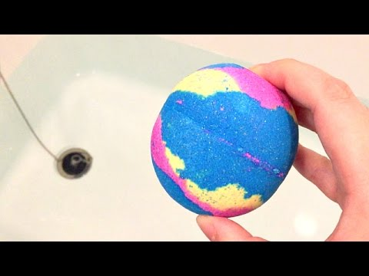
Notes:
Here is a video of a bath bomb for those of you who might be unfamiliar. Notice how the minute the bath bomb hits the water, it begins fizzing and dissolving. But how does this work? What makes that soapy sphere explode when it hits the bath?

Slide 7
What’s going on? VOCAB!
Ions: A molecule with an electrical charge
Molecule: A group of atoms bonded together
Acids: A positively charged molecule that can donate a proton
Bases: A negatively charged molecule that accepts protons
Acid-Base Reaction: A chemical reaction that occurs between an acid and a base where one or more hydrogen ions are exchanged.
Notes:
Before we get into the science behind what’s happening, lets dive into the terms first. Do any of these words look familiar to anyone? Have you maybe heard of acids and bases before in class? *Wait for audience participation*. Well, acids are a positively charged molecule that can donate a proton. Molecules contain protons, which are super-tiny, positively charged particles. Acids donate protons to other molecules, and Bases accept these protons. An Acid-Base reaction occurs when a proton from an Acid gets accepted from a Base.

Slide 8
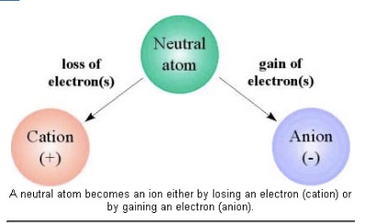
IONS
Negative
Charge
Positive Charge
Notes:
Before we get into the science behind what’s happening, lets dive into the terms first. Do any of these words look familiar to anyone? Have you maybe heard of acids and bases before in class? *Wait for audience participation*. Well, acids are a positively charged molecule that can donate a proton. Molecules contain protons, which are super-tiny, positively charged particles. Acids donate protons to other molecules, and Bases accept these protons. An Acid-Base reaction occurs when a proton from an Acid gets accepted from a Base.

Slide 9
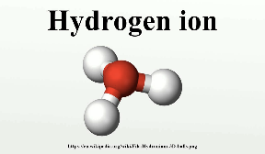
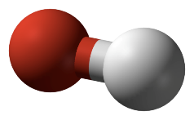
IONS IN ACIDS AND BASES
Hydroxide ion
- Found in acids
- Positive charge (H+)
- Attracted to bases
- Found in bases
- Negative charge (OH-)
- Accepts hydrogen
Notes:
Before we get into the science behind what’s happening, lets dive into the terms first. Do any of these words look familiar to anyone? Have you maybe heard of acids and bases before in class? *Wait for audience participation*. Well, acids are a positively charged molecule that can donate a proton. Molecules contain protons, which are super-tiny, positively charged particles. Acids donate protons to other molecules, and Bases accept these protons. An Acid-Base reaction occurs when a proton from an Acid gets accepted from a Base.

Slide 10
ACID BASE REACTIONS
Notes:
Before we get into the science behind what’s happening, lets dive into the terms first. Do any of these words look familiar to anyone? Have you maybe heard of acids and bases before in class? *Wait for audience participation*. Well, acids are a positively charged molecule that can donate a proton. Molecules contain protons, which are super-tiny, positively charged particles. Acids donate protons to other molecules, and Bases accept these protons. An Acid-Base reaction occurs when a proton from an Acid gets accepted from a Base.

Slide 11
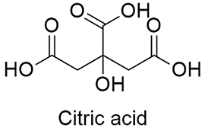
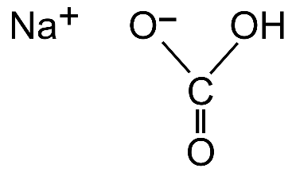
What’s going on?
An acid-base reaction occurs between citric acid and baking soda
Oxygen
Hydrogen
Carbon
Baking Soda
Oxygen, Hydrogen, and Carbon are all bonded via single and double bonds to form HCO3.
Recognize any of the elements?
Notes:
In order to make the fizz happen, an acid base reaction occurs between citric acid and baking soda. On the left, you can see the chemical structure of citric acid. On the right, you can see the structure of baking soda. Do any of the elements look familiar to you? Can you name them?

Slide 12
What’s going on?
Baking soda (NaHCO₃) dissolves in water and separates the positively charged sodium molecule (Na+) from the negatively charged bicarbonate (HCO3-).
|
|
|
|
|
|
|
|
|
Notes:
As you can see from the diagram, when baking soda interacts with water, it separates the positively charged sodium from the negatively sharged HCO3-. It’s splitting them apart!!!

Slide 13
What’s going on?
The citric acid (C₆H₈O₇) also dissolves in the water, separating a positively charged hydrogen molecule (H+).
|
|
|
|
Notes:
When the citric acid hits the water, something similar also happens. Look at how the Hydrogen, which has the positive proton, splits away from the rest of citric acid.

Slide 14
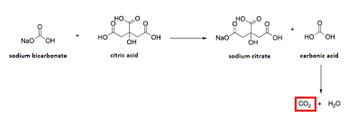
What’s going on?
Citric Acid donates a hydrogen (H+) to Baking Soda, which accepts it
Citric Acid donates the hydrogen. It is replaced by sodium.
Baking Soda accepts the hydrogen
Which one is the base? Which one is an acid?
Notes:
The bicarbonate, or baking soda, accepts the proton, the positively charged particle, from the citric acid. This produces carbon dioxide, as well as some other ions. Between the baking soda and the citric acid, which one is the base? Which one is the acid?

Slide 15
What’s going on?
This produces CO2, a fizzing gas that makes your bath fun and exciting!
Notes:
The bicarbonate, or baking soda, accepts the proton, the positively charged particle, from the citric acid. This produces carbon dioxide, as well as some other ions. Between the baking soda and the citric acid, which one is the base? Which one is the acid?

Slide 16
Chemical Engineering
Chemical Engineers make products like bath bombs every day!
Chemical Engineers...
Use chemistry and biology to solve real world problems
Apply scientific principles to create brand new chemicals and associated products
Manufacture medicines to help illnesses
Design plastics, papers, and dyes
… And so much more!
What are some things in your daily life that Chemical Engineers make?
Do you know any Chemical Engineers?
Notes:
*Read the Instructions* Demonstrate steps on camera!

Slide 17
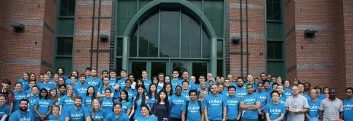
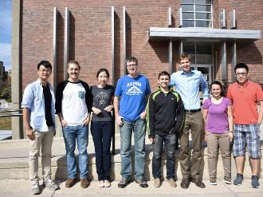
Chemical Engineering @ UConn
UConn offers a 4-year degree in Chemical Engineering. As a Chemical Engineering major, you will take courses like Organic Chemistry, Molecular and Cell Biology, and Thermodynamics.
Notes:
*Read the Instructions* Demonstrate steps on camera!

Slide 18
Ingredients in your kit
Dry Ingredients
1 packet Citric Acid
1 packet Cornstarch
1 packet Baking Soda
Wet Ingredients
Drops of Bath Bomb Soap Dye
1 Pipette
Utensils
2 Plastic Spoons
1 Bowl
1 Rubber Band
2 Gloves
Notes:
Let’s take a look at the ingredients we will need to make the bath bombs. Did you guess any of them correctly? *Identify correct guesses for ingredients from slide 5*. The materials needed to make our beautiful fizzy fragrances can be categorized into 4 groups: Dry Ingredients, Utensils, Wet Ingredients, and Decorations. Follow along with me as I cover what we’ll need so you can make sure you have everything. If anything is missing, please let a volunteer know ASAP! First, for dry ingredients, we will need citric acid, cornstarch, and baking soda. Next, for the utensils, we will need paper cups and two bowls. One will be for the dry ingredients and the other for the wet ingredients. For the wet ingredients, make sure you have soap dye and water. Last, but not least, we have dried flowers for decoration! *Volunteer will hold each item to the camera after covering the necessary materials*.

Slide 19
Lab Safety
This is just a reminder that while some of the ingredients look beautiful and smell amazing, we should still be extremely careful in handling them. Please notify a volunteer if there is an emergency!
Notes:
Alright! Now we can move forward and make the actual bath bombs! *Read the Slide*

Slide 20
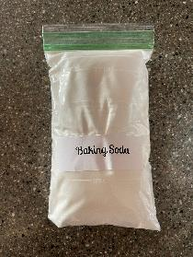
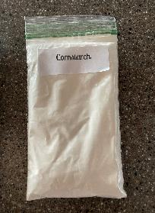
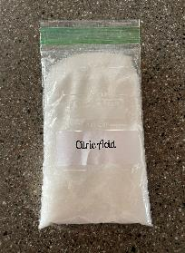
STEP
1
First, before we start, put on your safety gloves. Then, mix ½ the bag of baking soda, ½ the bag of citric acid, and ½ the bag of cornstarch together in the bowl.
Notes:
*Read the Instructions* Demonstrate steps on camera!

Slide 21
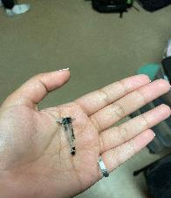
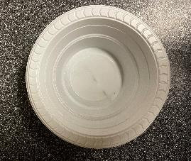
Pour 25-30 drops of water into the mixture using the pipette. Stir until you get a chalky mixture. Once you have properly mixed the ingredients, add the Bath Bomb Soap Dye into the bowl and stir!
STEP
2
Notes:
*Read the Instructions* Demonstrate steps on camera!

Slide 22
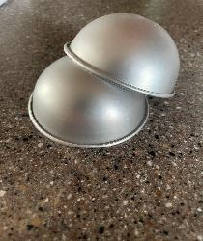
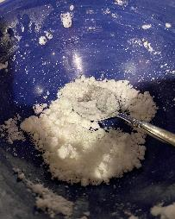
Press the ingredients into the bath bomb mold. Make sure the contents are packed tightly! For extra security, wrap a rubber band around the mold.
3
STEP
Notes:
*Read the instructions* Demonstrate steps on camera!

Slide 23
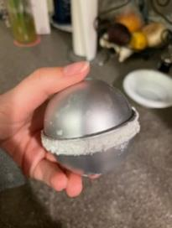
Let the bath bombs dry for a day before use! Then enjoy!
STEP
5
Notes:
*Read the instructions* Demonstrate steps on camera!

Slide 24
OVERVIEW
How was the bath bomb making experience?
Was there anything about the process that surprised you?
Have you used any of the ingredients before? While cooking or making crafts? How so?
If you have used bath bombs before, do your molds look like the ones you have at home?
Did you struggle with any of the steps?
Notes:
*Read the Instructions* Demonstrate steps on camera!

