Slide 1
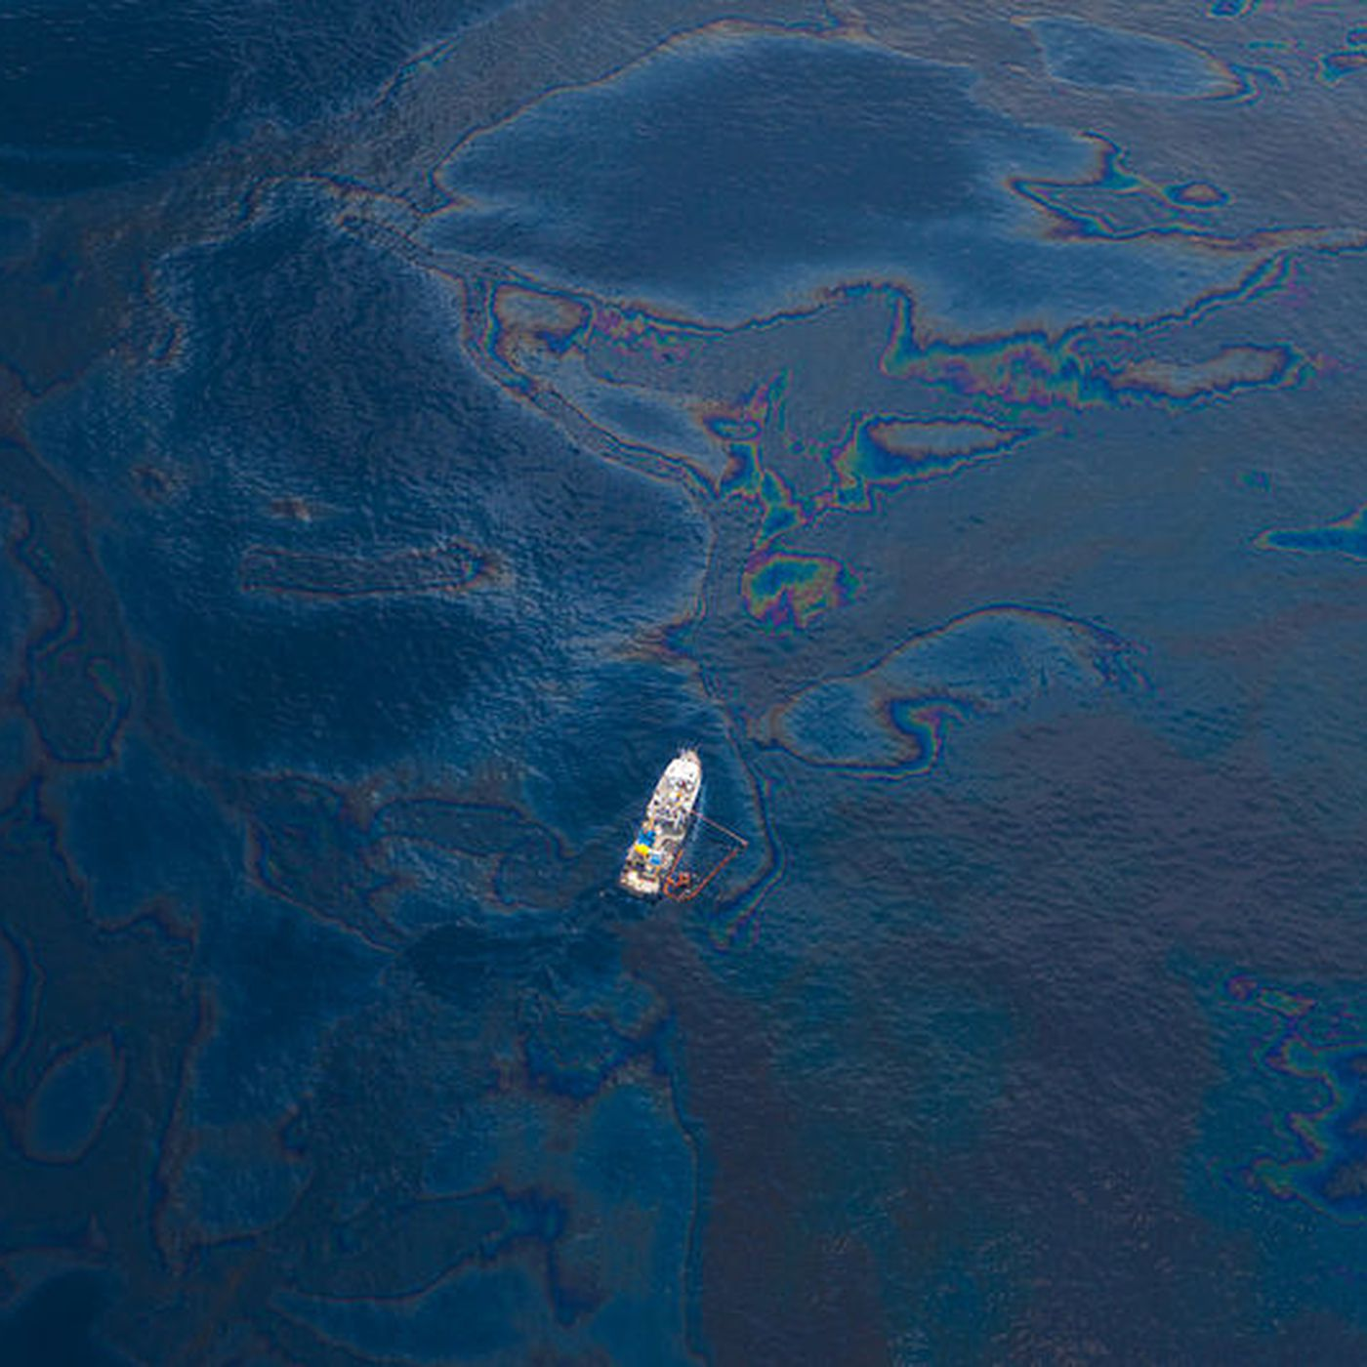
Oil Spill: Clean It Up!

Slide 2
Introductions
Name
Preferred pronouns
Major(s)
Why engineering and/or STEM?

Slide 3
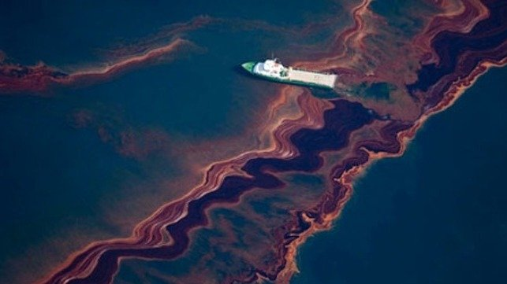
Oil Spills
Challenge solved by environmental and chemical engineers
Can harm wildlife, ecosystems and humans
Difficult to clean
Largest US oil spill:
Deepwater Horizon (2010)
Explosion of a drilling station
134 million gallons spilled
Restoration still continuing today

Slide 4
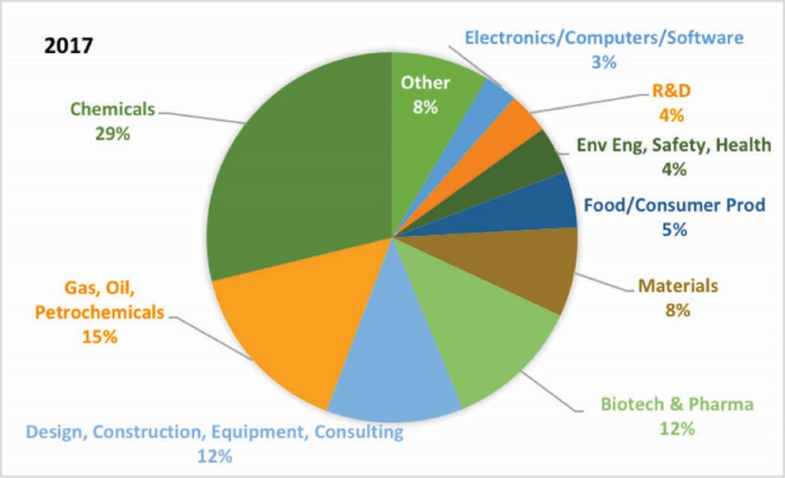
Who is involved in oil spills?
Environmental engineers
Chemical engineers
Coast Guard
Environmental Protection Agency
Oil companies
Animal scientists

Slide 5
Environmental Engineers
Work to prevent, control or repair environmental damage
Assess how human activity contributes to environmental change
Places of work:
Research lab
Field lab
Industry
Public health
Dr. Maria Chrysochoou

Slide 6
Chemical Engineers
Design new processes that help produce, transform or transport chemicals
Examples:
Biochemicals
Food chemicals
Clothing chemicals
Medicinal chemicals
Material chemicals
Environmental chemicals
Often work for large companies on multidisciplinary teams
Dr. Jennifer Pascal

Slide 7
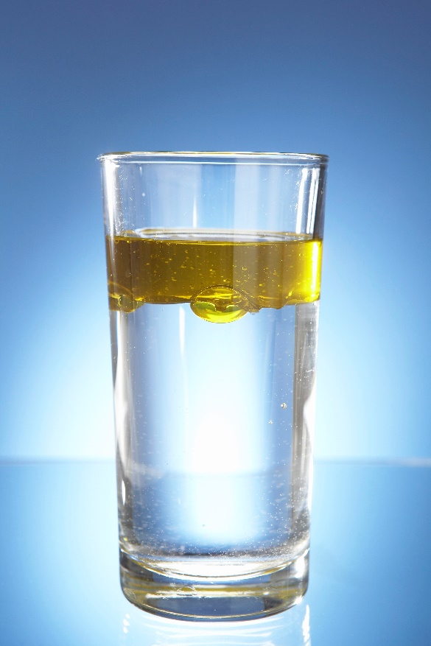
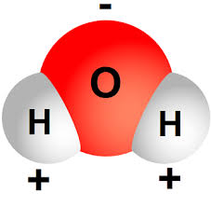
Why is oil so difficult to clean?
Water is polar, oil is non-polar
Water is more dense → oil will float on top

Slide 8
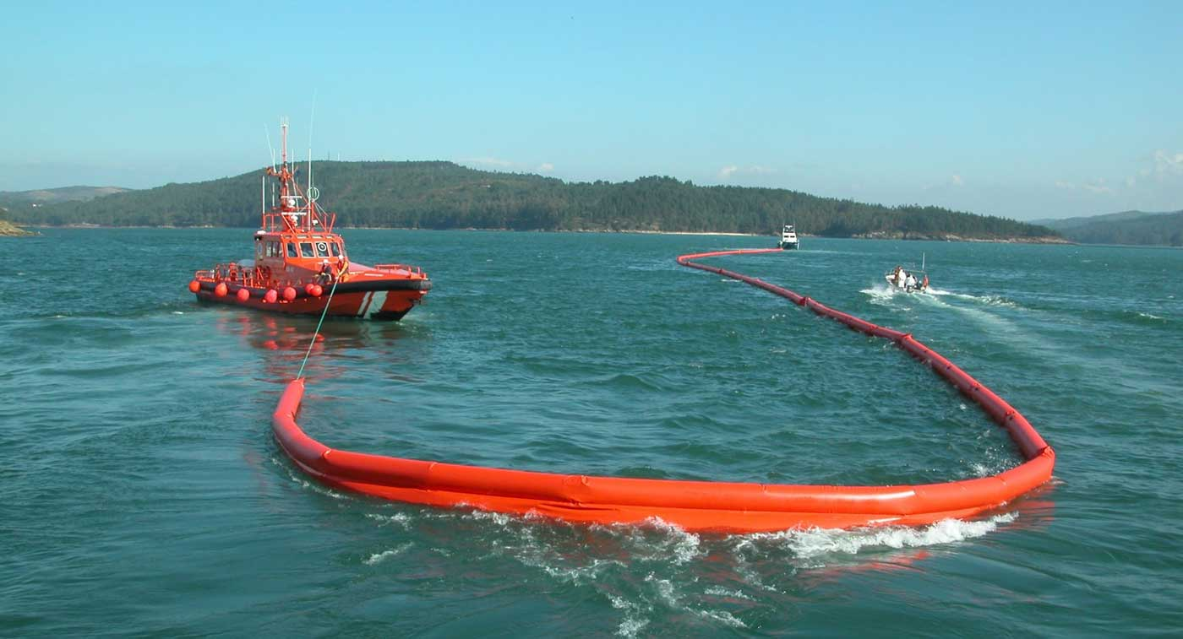
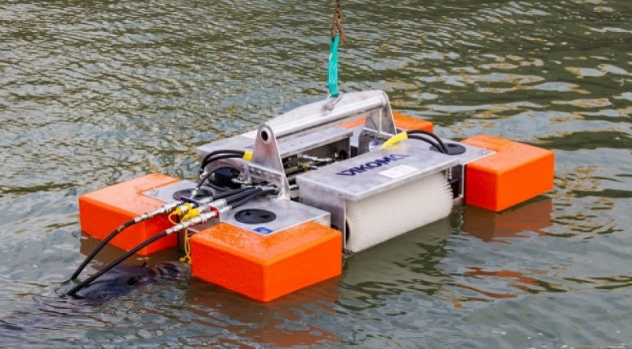
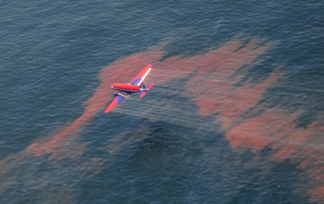
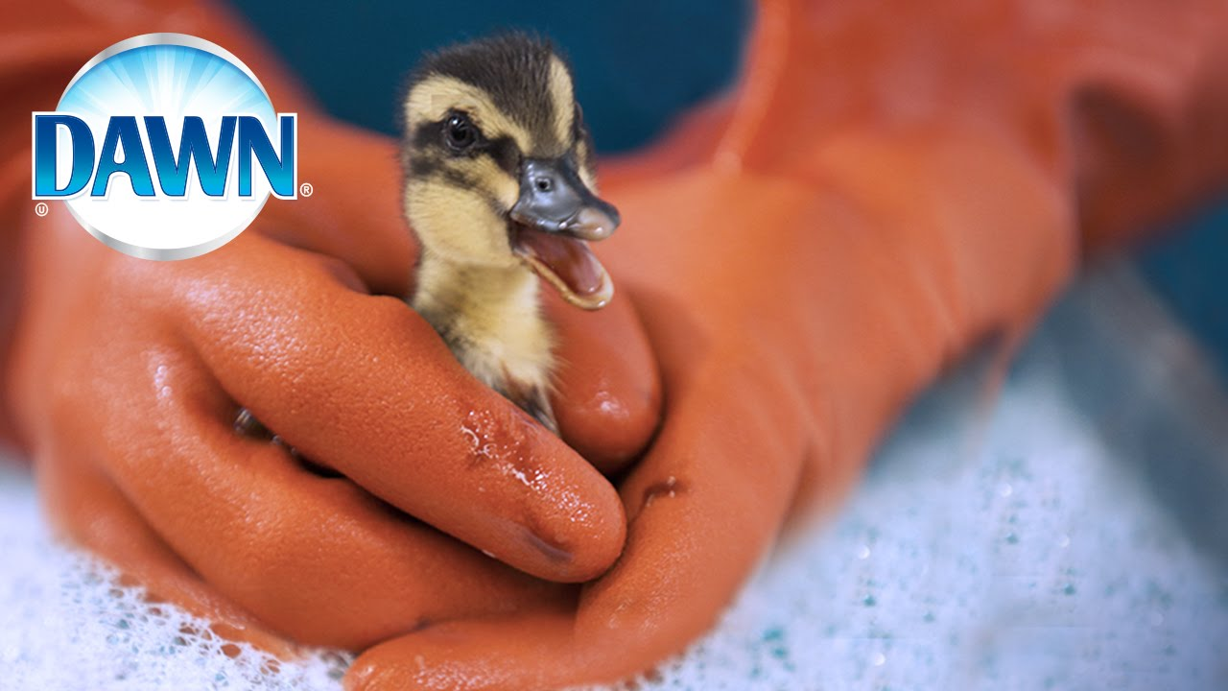
Oil Spill Experiment
Try to contain and remove oil:
Oil boom
Skimming
Absorption
Dispersant
Observe how wildlife may be affected

Slide 9
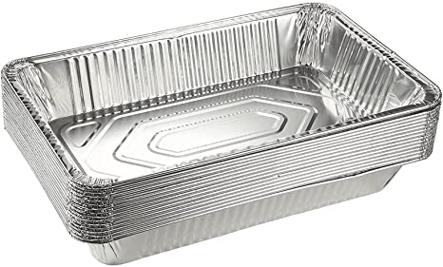
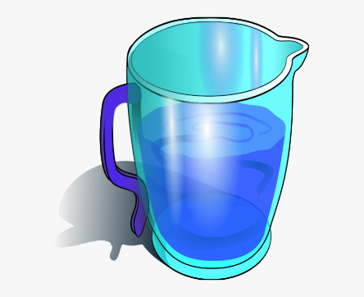
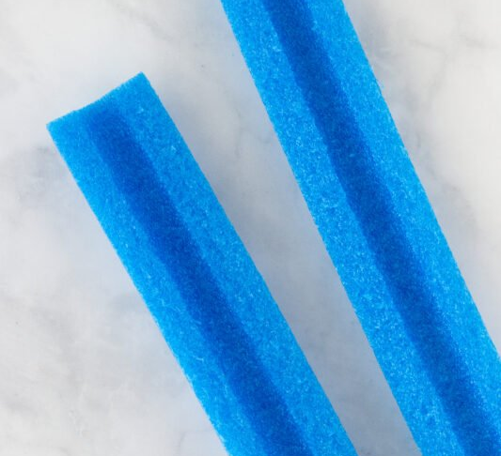
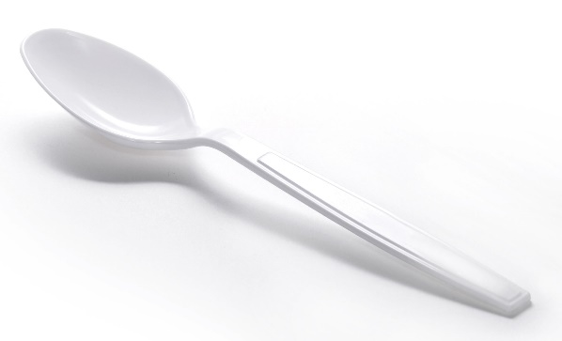
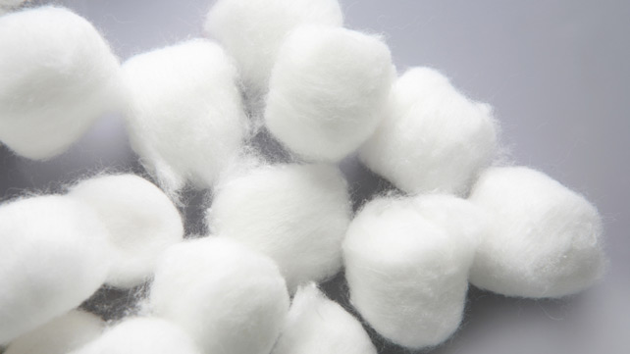
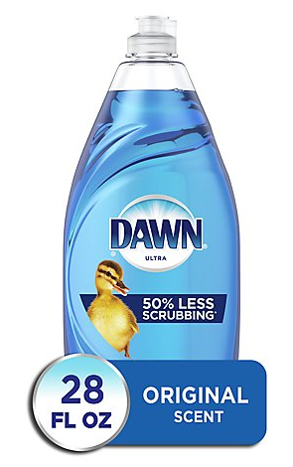
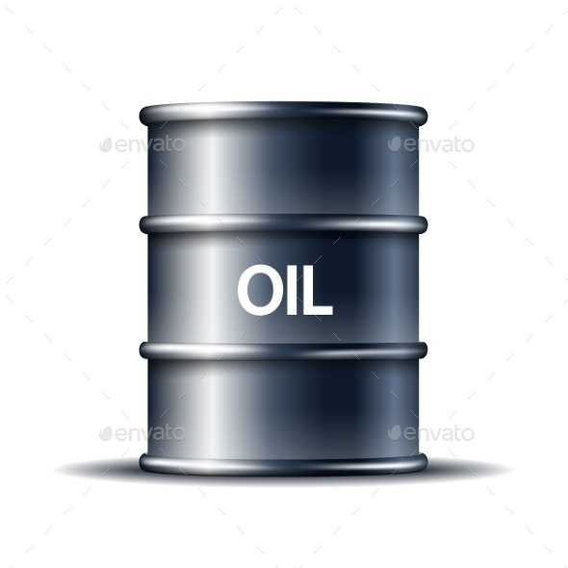
Materials
Rectangular pie pan
Water
Oil
Half foam tube
Popsicle sticks
Duct tape
Plastic spoon
Cotton balls
Dish soap
Feather

Slide 10
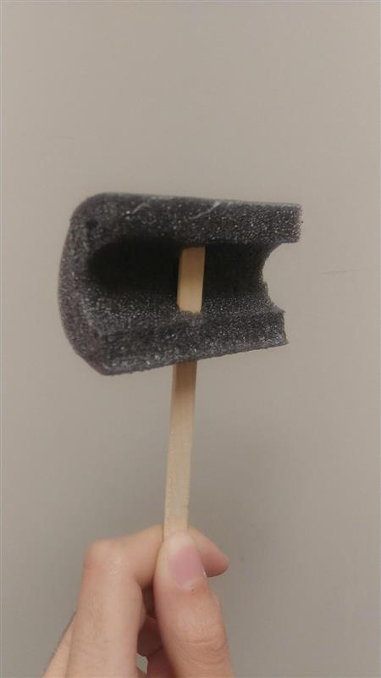
Step 1: Find the oil boom
What do you think a real oil boom could be made out of?
How much do you think a device like this would cost?

Slide 11
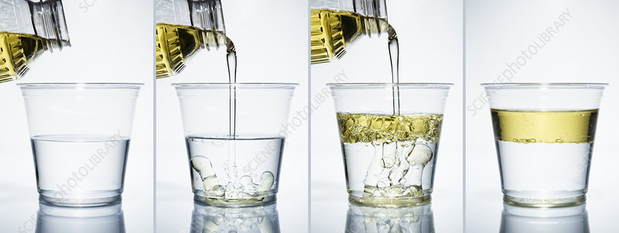
Step 2: Make the water and oil mixture
Pour water into the rectangular container
Fill up about 1/3 of the way full
Pour in the entire canister of oil
What do you notice happened when you poured the oil in?

Slide 12
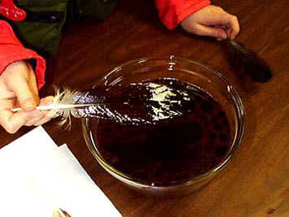
Step 3: Dip the feather in the oil
Dip the feather into the water/oil mixture
What happened to the feather?
How would this affect wildlife?
What could be done to solve this issue?

Slide 13
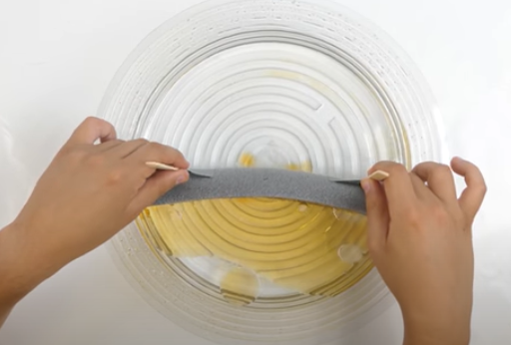
Step 4: Use the oil boom
Bend the oil boom to fit on one side of the container
Sweep across the container to section off all the oil into one smaller spot
How could engineers do this in an ocean or large body of water?

Slide 14
Step 5: Skim the surface with the spoon
Use the spoon to skim the surface of the water to try to remove the oil
How effective was this?
How could engineers do this on a real oil spill?

Slide 15
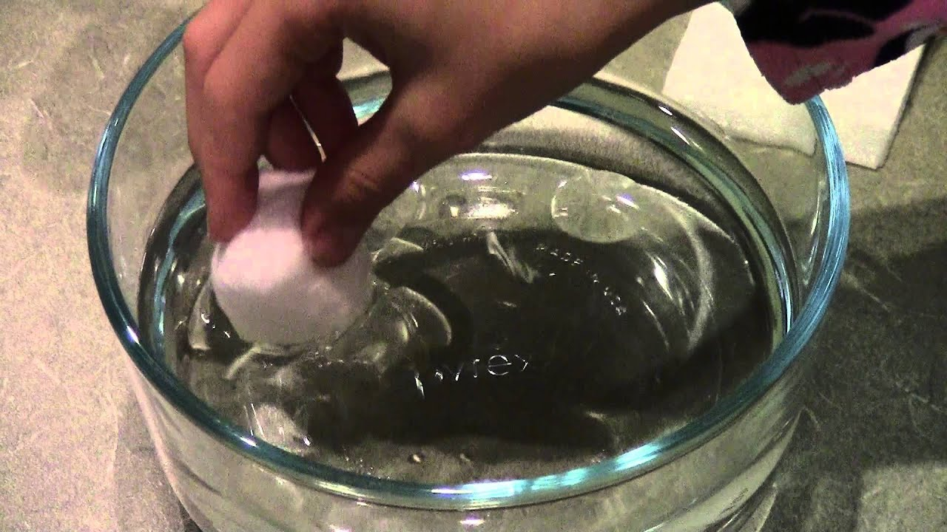
Step 6: Absorption
Lightly press a cotton ball on top of the oil to try to absorb it
What are some other example of materials that could be used to absorb oil?

Slide 16
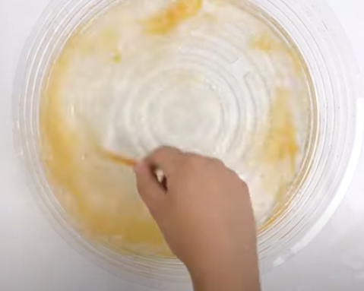
Step 7: Mix in dispersant
Remove the oil boom
Add two drops of dish soap to the water/oil mixture
Use the spoon to mix the soap into the mixture and disperse evenly
What do you notice happens to the oil?

Slide 17
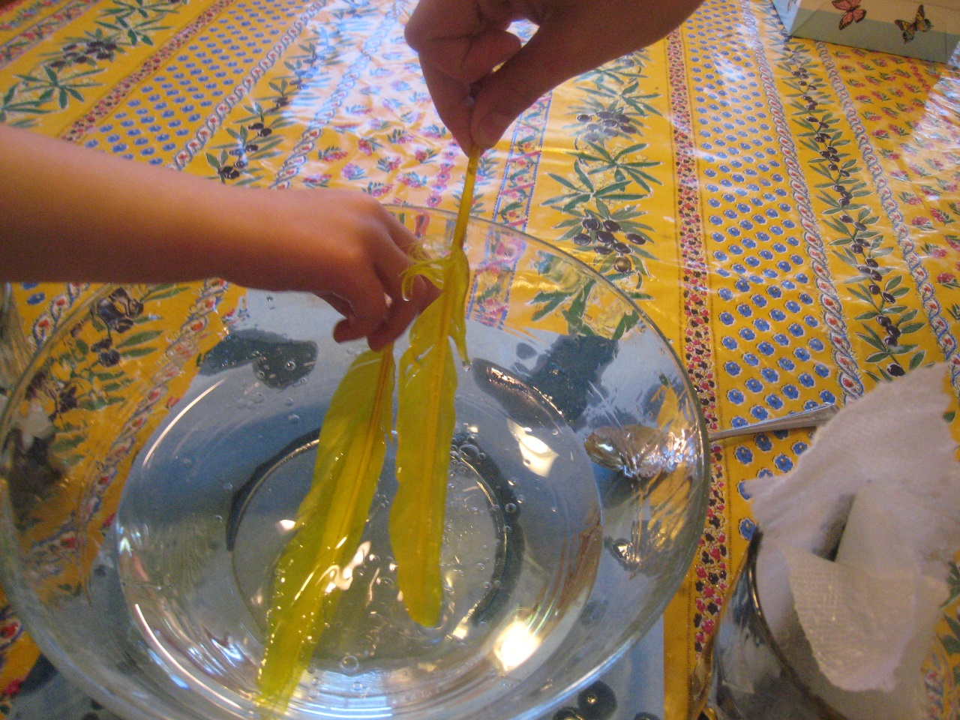
Step 8: Dip the feather in the new mixture
Dip a new feather into the water/oil/dish soap mixture
What happened to the feather?
How is this time different from the other feather dip?

Slide 18
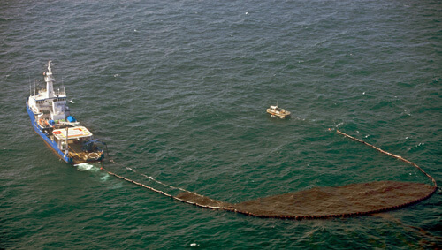
Conclusions
Did the methods to remove the oil work?
Were they effective?
Did they work as you predicted?

